Slide 1

Secure Instant Messaging
Shuangle Liao
Shihao Xu
Yangjing Liu
Dec 12, 2018

Slide 2
Instant Messaging examples
Services which provide instantly Internet message transfer.
E-mails
Blogs
Televisions
Games
They are integrated information platforms,
provide more than message transfer.

Slide 3
Instant Messaging Security Threats
Release of message contents
Masquerade
Modification of messages

Slide 4
Approaches
Release of message contents
message confidentiality
RSA, DES & D-H algorithm is usually used for encryption
Masquerade
Kerberos could make sure authentication of users with its AS
PKI registration provides a kind of authentication service

Slide 5
Approaches
Modification messages
Digital signature
One-way hash function

Slide 6
Instant Messaging examples
Qualified inastant messaging platforms should achive:
Transmission speed
Message integrity
Information confidentiality
User authentication

Slide 7
How to achieve those requirements?
Transmission speed
Network speed
Firewall
Encryption algorithm
Message integrity
Digital signature
SSL (Message Authentication Code)
IEEE 802.11i (Message Integrity Code)

Slide 8
How to achieve those requirements?
Information confidentiality
DES
3DES
AES
RC4 Algorithm
Authentication
Digtal signature
PKI

Slide 9
Our Implementation
RSA
authentication
&
key distribution
provides
information confidentiality
user authentication
DES
message encryption
provides
message confidentiality
MD5
digital signature
provides
message integrity
message confidentiality

Slide 10
Implementation details
Data confidentiality
Authentication
Data integrity

Slide 11


Implementation details
Data confidentiality
1001111101001111100000000001000001111011011110101011111111000101
Oh! Alice says “Hi”!
Hi!
Encryption
Decryption
???
Alice
Bob
Attacker

Slide 12
Implementation details
Data confidentiality
Hi!
1001111101001111100000000001000001111011011110101011111111000101
Hi!
Encryption
Decryption
Symmetric Cryptography

Slide 13
Implementation details
Authentication
Data integrity
Digital Signature
Alice’s public key
Alice
Bob

Slide 14
Implementation details
Authentication
Data integrity
Digital Signature
Really?
Attacker’s public key
Alice
Bob
I am Alice!
Attacker

Slide 15

Implementation details
Authentication
Data integrity
Digital Signature
Oh! Key comes from Alice!
Alice’s certificate
Alice
Bob
Certificate Authority

Slide 16
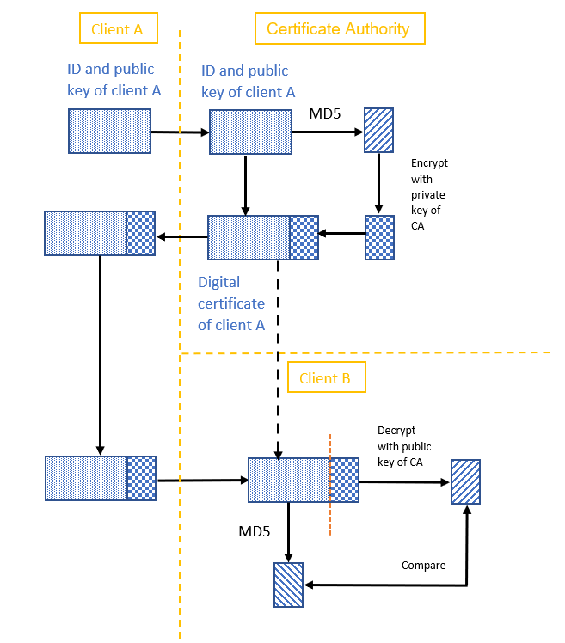
Implementation Models
Public Key and Certificate Distribution Model

Slide 17
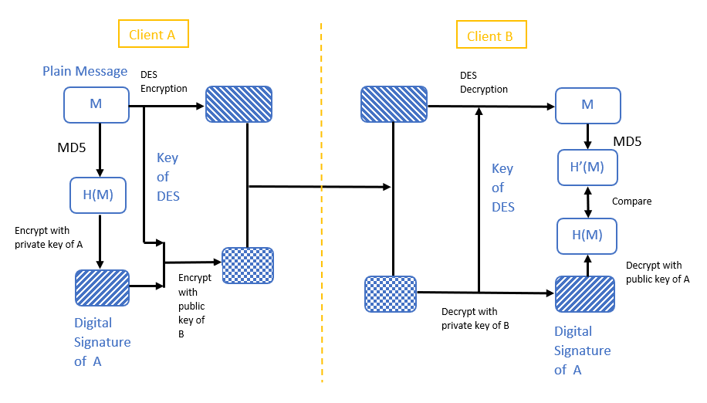
Implementation Models
Message Transmission Model

Slide 18
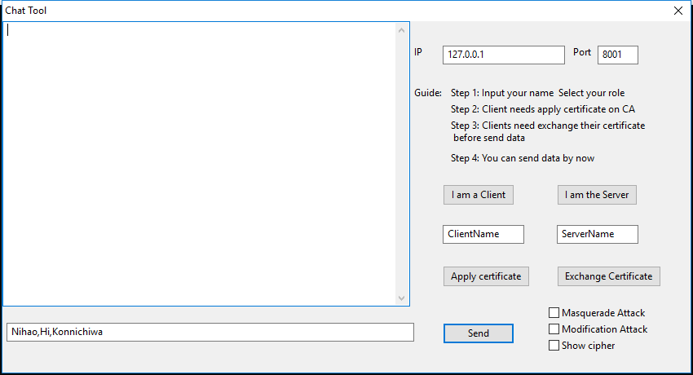
Graphical User Interface

Slide 19
Evaluation
Normal Mode
Modification Mode
Masquerade Mode

